Slide 1
Discrete Mathematics: Lecture 25 Part IV. Graph Theory Edge connectivity, Paths and Isomorphism, Counting Paths, Euler Paths and Circuits
Xuming He
Associate Professor
School of Information Science and Technology
ShanghaiTech University
Spring Semester, 2024
Notes by Prof. Liangfeng Zhang

Slide 2

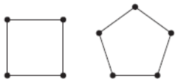
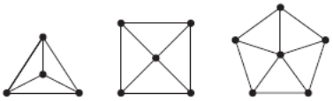
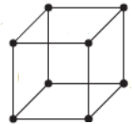
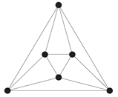





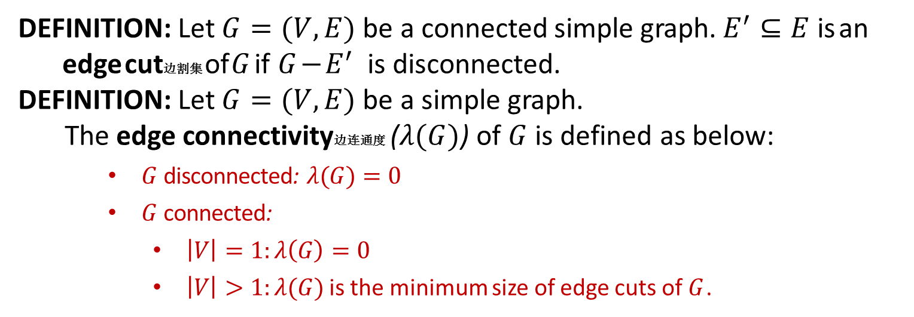







Edge Connectivity
DEFINITION: Let $G=(V,E)$ be a connected simple graph. $E^{′}⊆E$ is an
edge cut边割集 of $G$ if $G−E^{′}$ is disconnected.
DEFINITION: Let $G=(V,E)$ be a simple graph.
The edge connectivity边连通度 ($λ(G)$) of $G$ is defined as below:
$G$ disconnected: $λ(G)=0$
$G$ connected:
$\left|V\right|=1:λ\left(G\right)=0$
$\left|V\right|>1:λ(G)$ is the minimum size of edge cuts of $G$.
$$0$$
$$1$$
$$2$$
$$3$$
$$4$$
$$2$$
$$2$$
$$3$$
$$3$$
$$3$$
$$3$$
$$4$$

Slide 3
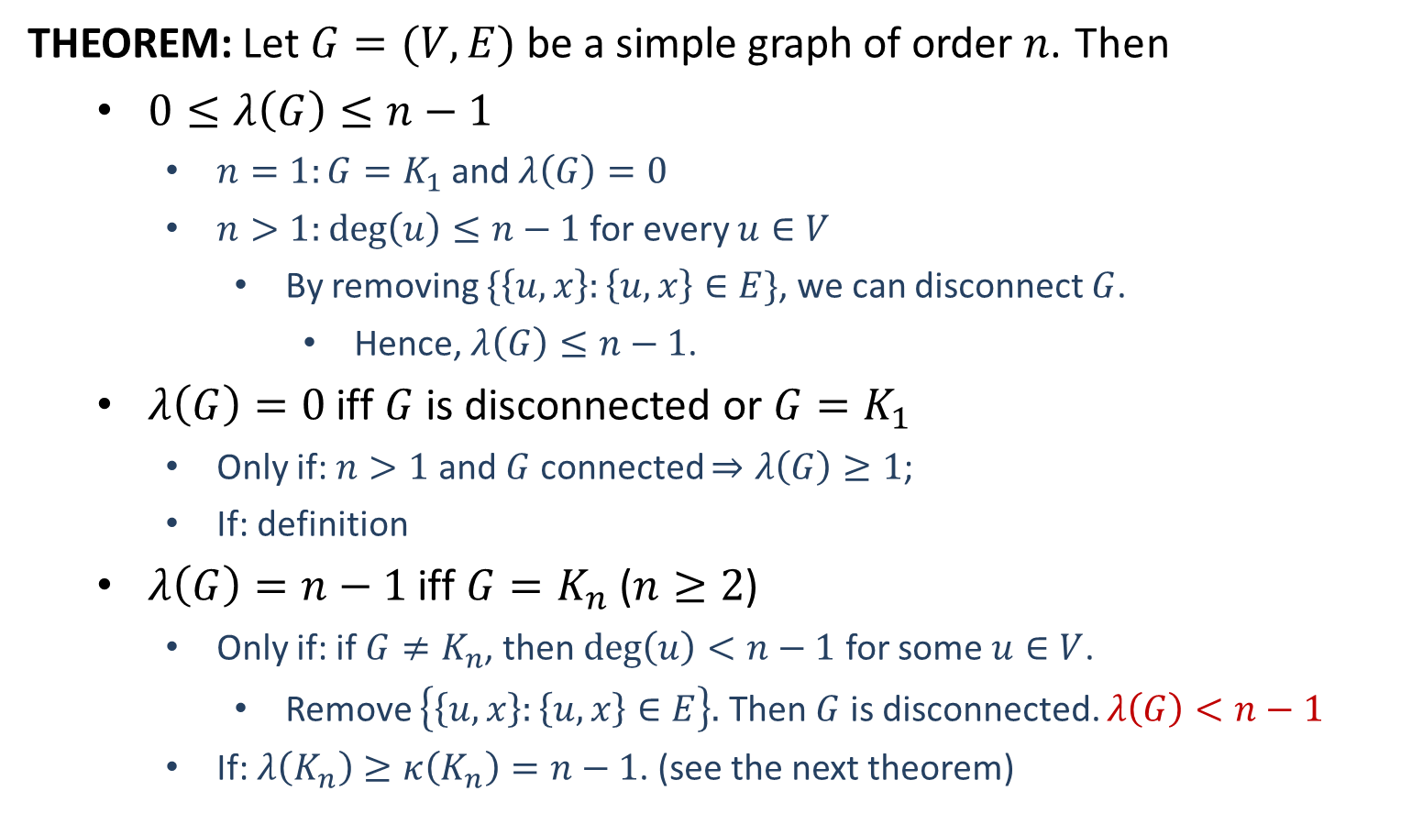
Edge Connectivity
THEOREM: Let $G=(V,E)$ be a simple graph of order $n$. Then
$0≤λ\left(G\right)≤n−1$
$n=1:G=K_{1}$ and $λ\left(G\right)=0$
$n>1:$ $\deg\left(u\right)≤n−1$ for every $u∈V$
By removing $\{\left\{u,x\right\}:\left\{u,x\right\}∈E\}$, we can disconnect $G$.
Hence, $λ\left(G\right)≤n−1$.
$λ\left(G\right)=0$ iff $G$ is disconnected or $G=K_{1}$
Only if: $n>1$ and $G$ connected $⇒λ\left(G\right)≥1$;
If: definition
$λ\left(G\right)=n−1$ iff $G=K_{n}$ ($n≥2$)
Only if: if $G≠K_{n}$, then $\deg\left(u\right)<n−1$ for some $u∈V$.
Remove $\left\{\left\{u,x\right\}:\left\{u,x\right\}∈E\right\}.$ Then $G$ is disconnected. $λ\left(G\right)<n−1$
If: $λ\left(K_{n}\right)≥κ\left(K_{n}\right)=n−1$. (see the next theorem)

Slide 4
Connectivity
THEOREM: Let $G=(V, E)$ be a simple graph. Then $κ\left(G\right)≤λ\left(G\right)≤δ(G)$,
where $δ\left(G\right)=\min_{v∈V}{\deg{(v)}}$ is the least degree of $G^{′}s$ vertices.
$κ\left(G\right)=2$
$λ\left(G\right)=3$
$δ\left(G\right)=4$
https://cp-algorithms.com/graph/edge_vertex_connectivity.html
http://www.math.caltech.edu/~2014-15/2term/ma006b/05%20connectivity%201.pdf

Slide 5
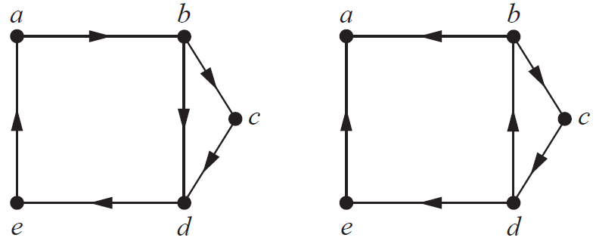
Connected Directed Graphs
DEFINITION: Let 𝐺 = (𝑉, 𝐸) be a directed graph. $G$ is said to be
strongly connected if there is a path from $u$ to $v$ and
a path from $v$ to $u$ for all $u,v∈V (u≠v)$.
weakly connected: the graph is connected if we remove the directions of all direct edges.
Strongly connected
Weakly connected

Slide 6
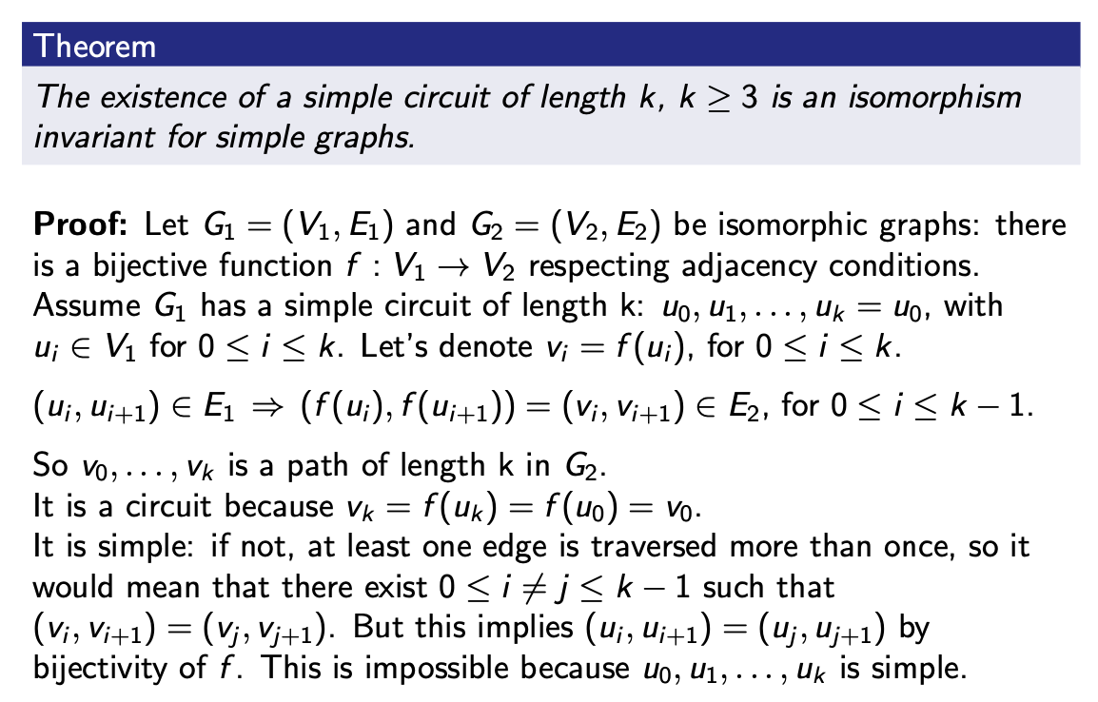
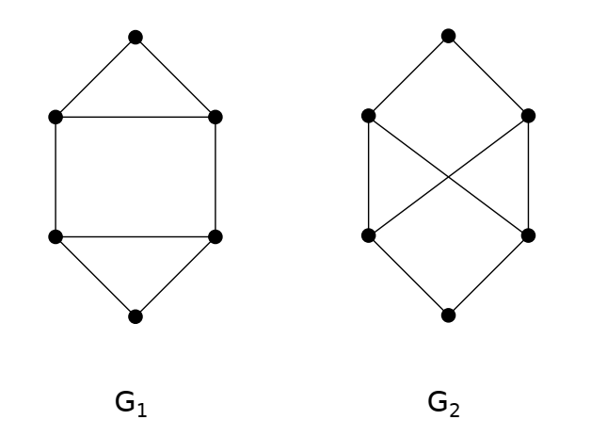

Paths and Isomorphism

Slide 7
Paths and Isomorphism*

Slide 8
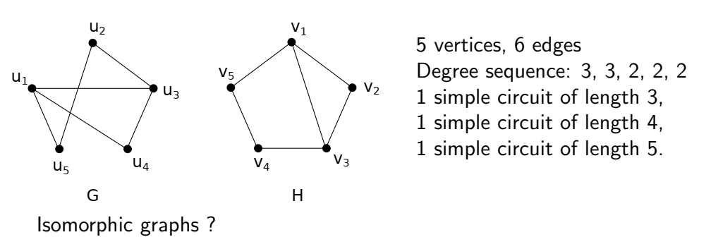
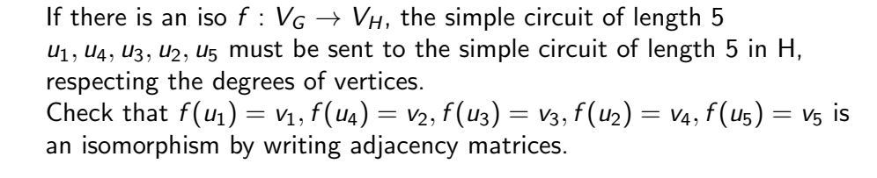

Slide 9
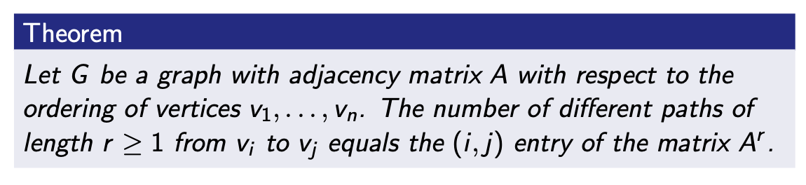
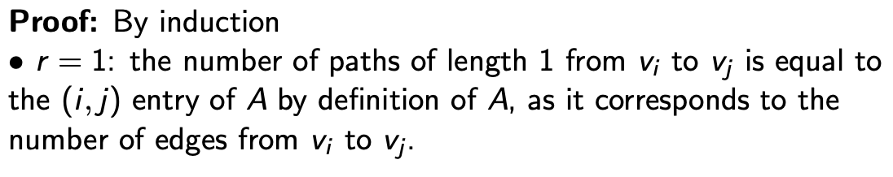
Counting Paths Between Vertices

Slide 10
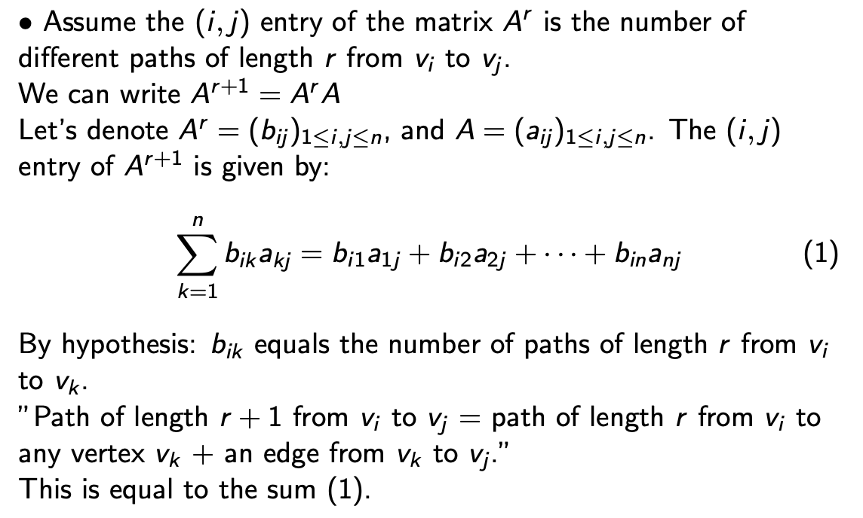

Slide 11
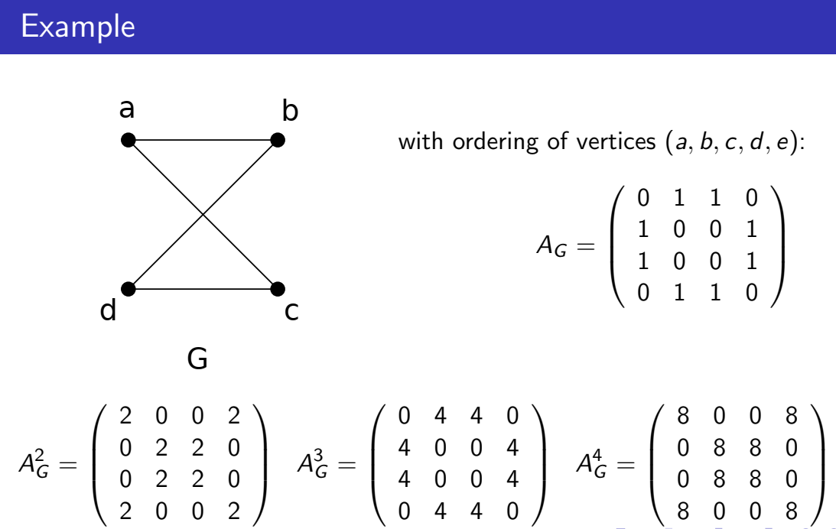

Slide 12
Euler Paths and Circuits
DEFINITION: Let $G=(V,E)$ be a graph.
Euler Path欧拉路径: a simple path that traverses every edge of $G$.
Euler Circuit欧拉回路: a simple circuit that traverses every edge of $G$.
Remark: When $G$ has multiple edges, these edges will be given different names and considered as different. This is implicit in the textbook.

Slide 13
Euler Circuits
THEOREM: Let $G=(V,E)$ be a connected multigraph of order $≥2$.
Then $G$ has an Euler circuit iff $2|deg⁡(x)$ for every $x∈V$.
$⇒$: Let $P:\left\{x_{0},x_{1}\right\}, …, \left\{x_{i−1},x_{i}\right\},…,\left\{x_{n−1},x_{n}\right\}$ be an Euler circuit, $x_{0}=x_{n}$
Every occurrence of $x_{i}$ in $P$ contributes 2 to $deg⁡(x_{i})$
Every vertex $x_{i}$ has an even degree
$⇐:$ Let $P: \left\{x_{0},x_{1}\right\},…,\{x_{n−1},x_{n}\}$ be a longest simple path in $G$.
Let $H=G\left[P\right],$ the subgraph of $G$ induced by all edges in $P$
If $x_{n}≠x_{0}$, then $\deg_{H}{(x_{n})}$ is odd and so $P$ cannot be longest.
$x_{n}=x_{0}, P$ is a simple circuit, and $2|\deg_{H}{(x_{i})}$ for all $i.$
If $∃i∈\{0,1,…,n−1\}$ such that $\deg_{H}\left(x_{i}\right)<\deg_{G}{(x_{i})}$,
then $∃y∈V$ such that $\left\{x_{i},y\right\}∉P$
$y,x_{i},x_{i+1},…,x_{n},x_{1},…,x_{i−1},x_{i}$ is longer than $P$
Hence, $\deg_{H}{(x_{i})}=\deg_{G}{(x_{i})}$ for all $i∈\{0,1,…,n−1\}$.
$V=\{x_{0},x_{1},…,x_{n−1}\}$ and $H=G$.
$P$ is an Euler circuit.
Remark: $H$ contains all vertices of $G$. Otherwise, $P$ can be extended.

Slide 14
Construction
ALGORITHM (Hierholzer):
Input: $G=\left(V,E\right),$ a connected multigraph, $2|\deg\left(x\right), ∀x∈V$
Output: an Euler circuit
$circuit:=a circuit in G$
$H:=G−circuit−isolated vertices$
$while H has edges do$
$subcircuit:=a circuit in H that intersects circuit$
$H:=H−subcircuit−isolated vertices$
$circuit:=circuit∪ subcircuit$
$return$ $circuit$

Slide 15
Example
$$a$$
$$b$$
$$a$$
$$b$$
$$e$$
$$c$$
$$e$$
$$c$$
$$f$$
$$f$$
$$d$$
$$d$$
$$a$$
$$b$$
$$a$$
$$b$$
$$e$$
$$e$$
$$c$$
$$f$$
$$d$$
$$circuit=a,b,e,a$$
$$H$$

Slide 16
Example
$$a$$
$$b$$
$$a$$
$$b$$
$$e$$
$$c$$
$$e$$
$$c$$
$$f$$
$$f$$
$$d$$
$$d$$
$$a$$
$$b$$
$$a$$
$$b$$
$$e$$
$$e$$
$$c$$
$$f$$
$$d$$
$$circuit=a,b,e,a$$
$$H$$
$$subcircuit=a,c,f,a$$

Slide 17
Example
$$a$$
$$b$$
$$a$$
$$b$$
$$e$$
$$c$$
$$e$$
$$c$$
$$f$$
$$f$$
$$d$$
$$d$$
$$a$$
$$b$$
$$b$$
$$e$$
$$c$$
$$e$$
$$c$$
$$f$$
$$f$$
$$d$$
$$circuit=a,b,e,a$$
$$H$$
$$subcircuit=a,c,f,a$$

Slide 18
Example
$$a$$
$$b$$
$$a$$
$$b$$
$$e$$
$$c$$
$$e$$
$$c$$
$$f$$
$$f$$
$$d$$
$$d$$
$$a$$
$$b$$
$$b$$
$$e$$
$$c$$
$$e$$
$$c$$
$$f$$
$$f$$
$$d$$
$$circuit=a,b,e,a, c,f,a$$
$$H$$

Slide 19
Example
$$a$$
$$b$$
$$a$$
$$b$$
$$e$$
$$c$$
$$e$$
$$c$$
$$f$$
$$f$$
$$d$$
$$d$$
$$a$$
$$b$$
$$b$$
$$e$$
$$c$$
$$e$$
$$c$$
$$f$$
$$f$$
$$d$$
$$circuit=a,b,e,a, c,f,a$$
$$H$$
$$subcircuit=c,d,e,f,b,c$$

Slide 20
Example
$$a$$
$$b$$
$$a$$
$$b$$
$$e$$
$$c$$
$$e$$
$$c$$
$$f$$
$$f$$
$$d$$
$$d$$
$$a$$
$$b$$
$$e$$
$$c$$
$$f$$
$$d$$
$$circuit=a,b,e,a, c,f,a$$
$$H$$
$$subcircuit=c,d,e,f,b,c$$

Slide 21
Example
$$a$$
$$b$$
$$a$$
$$b$$
$$e$$
$$c$$
$$e$$
$$c$$
$$f$$
$$f$$
$$d$$
$$d$$
$$a$$
$$b$$
$$e$$
$$c$$
$$f$$
$$d$$
$$circuit=a,b,e,a,c,d,e,f,b,c,f,a$$

Slide 22
Euler Paths
THEOREM: Let $G=(V,E)$ be a connected multigraph of order $≥2$.
Then $G$ has an Euler path (not Euler circuit) iff $G$ has exactly 2
vertices of odd degree.
ALGORITHM:
Input: $G=\left(V,E\right),$ a connected multigraph, $x,y∈V$ have odd degrees
Output: an Euler path
$H≔G+\{x,y\}$
$find an Euler circuit using Hierholzer^{′}s algorithm$
$remove the edge \{x,y\} from the circuit$
$$a$$
$$b$$
$$a$$
$$b$$
$$e$$
$$c$$
$$e$$
$$c$$
$$a,c,d,e,f,b,a,e,b,c,f,a$$
$$f$$
$$f$$
$$a,c,d,e,f,b,a,e,b,c,f,a$$
$$d$$
$$d$$
$$a,e,b,c,f,a,c,d,e,f,b$$

Slide 23
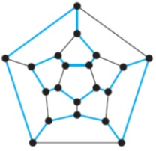
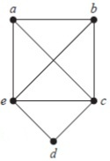
Hamilton Paths and Circuits
DEFINITION: Let $G=(V,E)$ be a graph.
Hamilton Path: A simple path that passes through every vertex exactly once.
Hamilton Circuit: A simple circuit that passes through every vertex exactly once.
√ Hamilton path
√ Hamilton circuit
√ Hamilton path
√ Hamilton circuit
√ Hamilton path
$×$Hamilton circuit
$×$ Hamilton path
$×$Hamilton circuit

Slide 24
Hamilton Circuits
Determine if there is a Hamilton circuit in a given graph $G$?
This problem is NP-Complete. //that means very difficult
Necessary conditions on Hamilton circuit.
If $G$ has a vertex of degree 1, then $G$ cannot have a Hamilton circuit.
If $G$ has a vertex of degree 2, then a Hamilton circuit of $G$ traverses both edges.
Sufficient conditions on Hamilton circuit.
Ore’s Theorem: Let $G=(V,E)$ be a simple graph of order $n≥3$. If $\deg\left(u\right)+\deg\left(v\right)≥n$ for all $\left\{u,v\right\}∉E$, then $G$ has a Hamilton circuit.
Dirac’s Theorem: Let $G=(V,E)$ be a simple graph of order $n≥3.$ If $\deg\left(u\right)≥n/2$ for every $u∈V$, then $G$ has a Hamilton circuit.
This is a corollary of Ore’s Theorem
$∀u∈V, \deg\left(u\right)≥n/2⇒∀u,v∈V,\deg\left(u\right)+\deg\left(v\right)≥n$

Slide 25
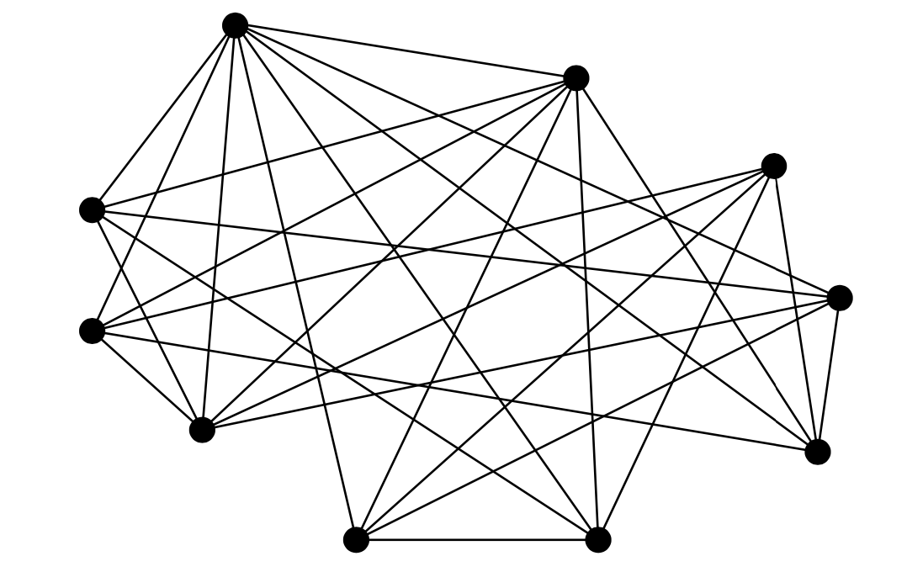
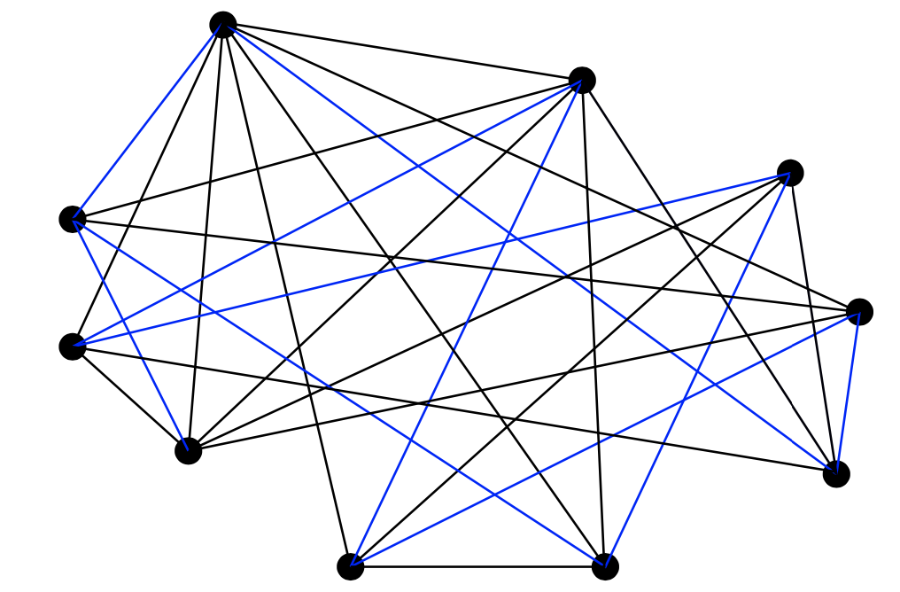
Hamilton Circuits
Examples (sufficient condition)

Slide 26
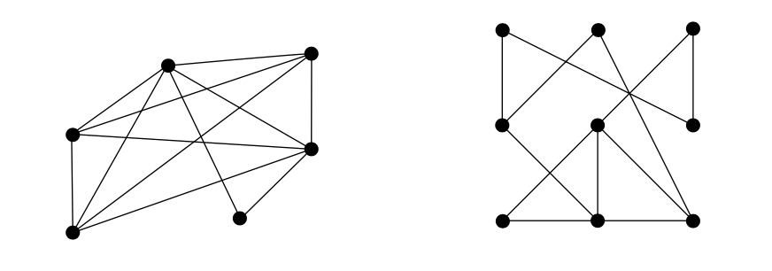
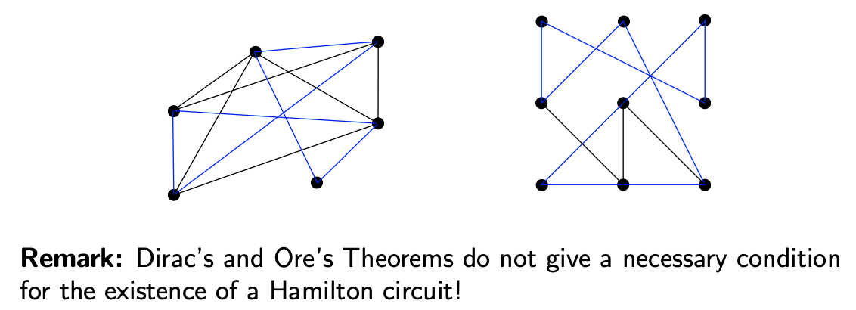
Hamilton Circuits

Slide 27
